Slide 1
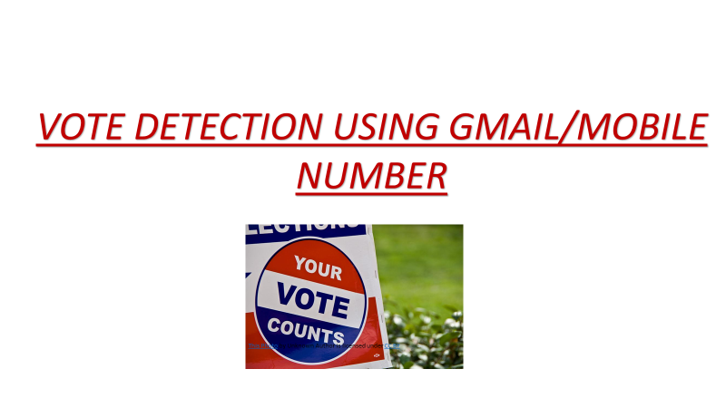


Slide 2
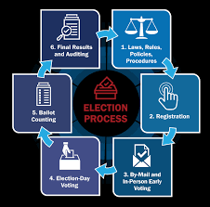
PROCESS

Slide 3
PROBLEM STATEMENT :
Even though our Country has taken steps towards Digitalization of India, considering the progress of Voting System it still has some flaws. Registration of Votes is being possible only if people go to polling booths for the current system. During the time of voting, voter’s name is listed in the list of his/her respective area. They cannot vote outside the vicinity of the address mentioned in the voting card. So people who are migrated to other places cannot cast the vote physically. The recent pandemic situation of Corona Virus shows us the risk of this system. This can lead to failure of social distancing during voting process, as the voter needs to be physically present for casting the vote

Slide 4
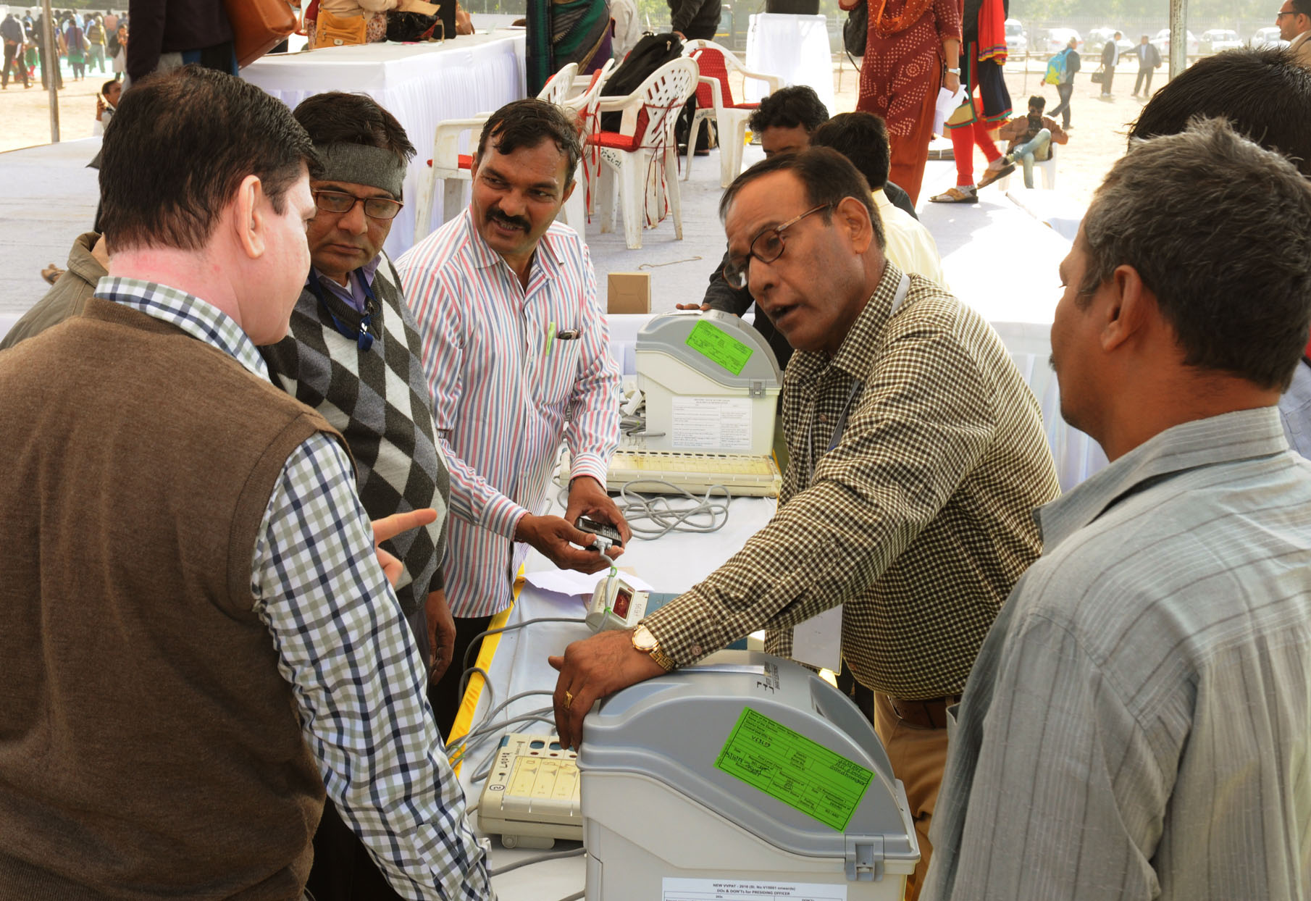
TYPES OF SURVEYS :
1.ELECTRONIC VOTING MACHINE WITH SECURITY:
This paper describes the construction and design of voting machine using ATMEGA 32 microcontroller which has security of three extra layers. EVM takes a lot of time for the process of voting using ballot papers. So considering to the amount of time, manpower to be saved for extremely fast and reliable. So here implementation of the system is in such a way that voting secrecy is maintained without using ballot paper. VVPAT is currently used for voting machine which is expensive than EVM. EVM gives 100% proof of tamper, where results are just a click away. But this EVMs can be tampered easily by changing the hardware connections. So this paper proposes a three layered extra security
This Photo by Unknown Author is licensed under CC BY-SA

Slide 5
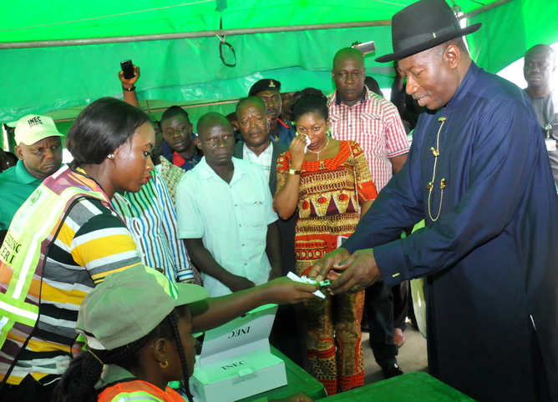
2.Biometrically Secured Electronic Voting Machine :
In this paper, Arduino and Finger print scanner is used to implement the system which identifies each voter, also count votes and avoids fake votes. In this system voter is identified using FPS which detects if a person is a registered or not and also it denies for the voter to cast the second vote.

Slide 6
ADVANTAGES:
* Biometric description of voter is used
*Speed of counting of ballots is increased using this application .
* User just needs to have Aadhaar card number.
*Less Time Is Required
* Saves the cost of paying staff as there is no need to count votes manually.

Slide 7
DISADVANTAGES :
* Advanced security system can be required for significance of investments and costs
* Risk of fraud can happen.
* Security risk present.
LIMITATIONS:
* Application should be known to users
* Issue of Compatibility can occur.
* Smartphone is required for this system

Slide 8
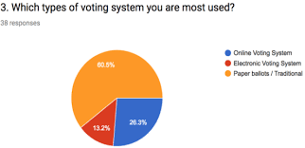
PIE CHART:

Slide 9
CONCLUSION:
Our proposed solution is machine learning based with gmail/mobile number which allows the voter to register and he/she can vote from anywhere irrespective of the location. This system provides security and also avoid casting of the multiple vote by same person. This system is more reliable in which we can vote from multiple locations. It also minimize work, human requirements and time resources.

Slide 10

PROJECT TEAM MEMBERS:
D.DURGA PRASAD
B.ARESH
R.MOUNIKA
M.JYOTHI
T.DHARANI
N.RATNA KUMARI

Slide 11


